Slide 1
Motorized Off-Road Vehicle Training
Campus Safety and University Operations Division
Risk Management & Safety Department

Slide 2
Training Outline
Purpose
Definitions
Enforcement
General Requirements
Motorized Off-Road Vehicle (MOV) Rentals
Vehicle Operations
Quiz

Slide 3
Purpose
The purpose of the University of Notre Dame MOV policy and training is to ensure safe and efficient operation of MOVs.
The policy applies to the operation of all MOVs on campus property.

Slide 4
Definitions
Motorized Off-Road Vehicle (MOV): vehicles not intended for road use nor licensed under the laws of any state including golf carts, Cushman vans, Bobcat utility carts, gators, ATVs, and other similar devices.
Authorized Driver: a person who meets the University requirements and has completed Risk Management & Safety’s on-line training.
Responsible Usage: use of the MOV in a manner that is not reckless or irresponsible and utilizing approved routes.
Approved Vehicle: a vehicle that has been registered with Transportation Services.
Authorized Use: University business purposes and other ‘responsible usage’ reasons by authorized drivers. MOVs must not be taken off campus grounds or driven on city or county streets. All University employees and students must adhere to the Vehicle Usage Policy for Notre Dame Employees / Students.

Slide 5
Enforcement
NDSP will enforce this policy.
Citations may be issued for reported or observed MOV rule violations or unsafe driving.
Rules regarding MOV operation will be enforced throughout the year.
Users of unauthorized MOVs will be informed of this policy and asked to leave campus.
Unregistered MOVs found on campus may be ticketed.
Enforcement efforts for repeat offenders may escalate to issuing a “No Trespass” order to the operator, impounding the vehicle at operator’s expense or otherwise removing vehicle/operator from campus.

Slide 6
Acquiring a MOV

Slide 7
Purchasing
Transportation Services is responsible for coordination of new vehicle and MOV purchases and should be contacted when departments anticipate a need. Rental arrangement inquiries can also be made through Transportation Services.

Slide 8
General requirements

Slide 9
General Requirements
Authorized Use: University MOVs are to be used for business purposes and other ‘responsible usage’ reasons by authorized drivers. MOVs must not be taken off campus grounds or driven on city or county streets. All University employees and students must adhere to the Vehicle Usage Policy for Notre Dame Employees / Students.
Training: MOV use training is required for all individuals who may drive an MOV on University grounds.
Insurance: Liability and physical damage insurance is provided by the University for University-owned vehicles. A deductible will be charged to the user’s department budget in the event of an accident or theft. The University employee or student responsible for the vehicle may be personally liable for the entire loss should the University vehicle be used by an unauthorized individual.

Slide 10
Equipment Requirements
The following equipment is required on all golf carts operated on campus as of May 1, 2015:
Headlights
Taillights
Rear-view mirrors
The following equipment is required on all utility vehicles operated on campus as of May 1, 2015:
Headlights
Taillights
Rear-view mirrors
Turn signals

Slide 11
Registration and Approval
All MOVs whether leased, rented or owned by the University must be registered with Transportation Services prior to being brought on or operated on campus.
Transportation Services will assign an identification number and sticker for all approved vehicles that must be clearly and visibly displayed on the vehicle at all times.
MOVs used solely for golf course purposes that do not leave golf course grounds are exempt from registration and approval processes.

Slide 12
MOV Rentals

Slide 13
MOV Rentals
All MOV rentals must be coordinated through Transportation Services or the delivery of the vehicles to campus will be denied.
A rental request form can be downloaded from the Transportation Services website http://transportation.nd.edu/ . Officer approval is required. Two week lead time is requested.
MOV reservations must be cancelled one week in advance to avoid charges.
Report all accidents or damage to Notre Dame Security Police (NDSP), Transportation Services and Risk Management and Safety.
Rental and fuel fees will be charged to the user’s department as appropriate.
Vehicles must be picked up at Transportation Services during normal business hours (7:00am – 4:30pm M – F). Transportation Services is located in the garage on St. Joseph Drive.

Slide 14
MOV Rentals
Users are required to show valid driver’s license and sign for the key.
Users must not permit any unauthorized person to operate the vehicle except in an emergency.
Users are responsible for the deductible if the vehicle is damaged, lost or stolen.
Users are required to abide by all applicable motor laws and should drive the vehicle at legal speeds appropriate for pedestrian, weather, and road conditions.
The vehicle and keys should be returned to Transportation Services during normal business hours (7:00am – 4:30pm M – F).

Slide 15
Vehicle Operations

Slide 16
Requirements
PEDESTRIANS ALWAYS HAVE THE RIGHT OF WAY!
Only University faculty/staff/students and authorized drivers are permitted to operate University-owned MOVs on campus.
Individuals must be 18 years of age and complete Risk Management & Safety training before being authorized to operate vehicles.
Only operate MOVs on authorized roads/walkways (consult map on steering wheel)
Drive the vehicle at speeds appropriate for pedestrian, weather, road, and light conditions
Passenger load may not exceed the number of seats provided.

Slide 17
Requirements
Wearing headphones or using a cell phone while operating MOVs is prohibited.
Smoking and alcohol consumption is prohibited in/on the vehicle.
Individuals must not operate MOVs while under the influence of alcohol or drugs.
All MOVs should be parked safely away from pedestrian/vehicular traffic.
All MOVs must be locked when parked and unattended.
MOV operation on city streets or roads is prohibited. Vehicles are prohibited from crossing Angela Boulevard, Edison Road, Twyckenham Drive, Douglas Road, and US 933.

Slide 18
Requirements
Promptly report any accident, damage, or theft incurred while operating a MOV to NDSP, Transportation Services and Risk Management & Safety.
Contact Transportation Services for winter storage options.
The requirements outlined in the Vehicle Usage Policy for Notre Dame Employees or the Vehicle Usage Policy for Notre Dame Students apply to MOV usage.
http://riskmanagement.nd.edu/safety-policies-consumer-warnings-and-reports/vehicle-usage-policies/

Slide 19
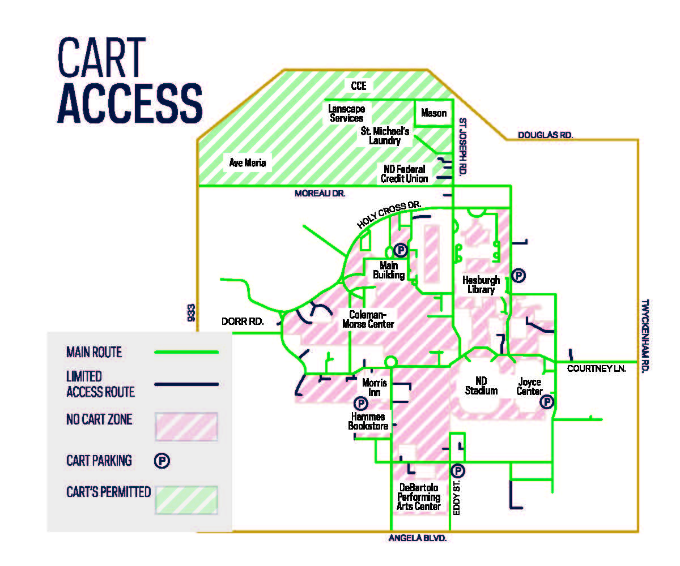
MOV Access & Routes

Slide 20
Pre-Driving Instructions/Checklist
Conduct a visual inspection prior to operating the MOV.
Read operating instructions located on the steering wheel and floor board.
Ensure campus map of permissible roadways is present on steering wheel
Cart must be at a complete stop before switching gears.
When parking, set the parking brake, remove the key and lock steering wheel with cable/lock. Carts must be locked when unattended to prevent theft.
Headlights must be turned on at dusk and when it is raining or snowing.

Slide 21
Quiz
Please complete the following quiz and check your answers
My department does not need to register their vehicle with Transportation Services if it is already registered with Risk Management & Safety
True
False
If my department wishes to rent a golf cart for an upcoming event, we must coordinate that through Transportation Services.
True
False
MOVs used solely for golf course purposes that do not leave the golf course are exempt from registration and approval processes.
True
False
What safety equipment is required on all MOVs operated on campus?
Headlights
Taillights
Rear-view mirrors
All of the above
Pedestrians should avoid MOVs as carts have the right of way on campus.
True
False

Slide 22
Quiz (page 2)
The following are covered by the University MOV policy:
Golf carts
Bobcat Utility Carts
ATV’s
Cushman Vans
All of the above
The following departments should be notified of any accident, damage, or theft incurred while operating a MOV on campus
Risk Management and Safety
Notre Dame Security Police
Transportation Services
All of the above
The following components may be applied when enforcing the University’s MOV policy:
Ticketing unregistered MOV’s found on campus
Issuing a “No Trespass” order to repeat offenders
Asking users of unauthorized MOV’s to leave campus
All of the above
Authorized MOV drivers may operate (drive) a MOV anywhere on campus.
True
False
Cell phone use by an operator is permissible while driving a MOV.
True
False

Slide 23
Quiz (answers)
Please check your answers
False
True
True
All of the above
False
All of the above
All of the above
All of the above
False
False

Slide 24
Certification (print this page)
I attest to having reviewed the entire presentation and understand proper operation of any Motorized Off-Road Vehicle (MOV) on campus.
I will operate any MOV in my charge in accordance with these guidelines.
(Please print and sign and return to Transportation Services)

